Slide 1
SLT: Staff Networking Survey
60 responses in total
10 of which were TA/SP
36 said they were already involved in a network of some sort
Other networks/Groups include:
CEN, SSD, ADOS, Clinical Supervision, Language Forum, Speech Forum, Complex needs SPAG (B7+), Feeding Forum, Special Needs Forum, GLP Forum, Trust Forums (H&W, LGBTQ, Disability), Mentoring Group, Local Team Chat (MS Teams), Quarterly Service Leads Meetings, SPAG Speech and DLD, one off specialist groups,

Slide 2
SLT: Staff Networking Survey
What does or would motivate you to join or participate in a staff peer group?
Support & Challenge: Desire for a supportive environment that also challenges them to grow.
Positive Culture & Safe Space: Desire for a positive and open culture where they feel safe to share.
Good Outcomes & Evidence-Based Practice: Motivation derived from seeing positive outcomes and practicing evidence-based methods.
Professional Growth: Interest in opportunities for continuous professional development and engagement with research.
Sharing Knowledge & Learning: Importance placed on sharing ideas, best practices, and clinical knowledge. Appreciation for peer support, diverse experiences, and learning from different perspectives.
Networking & Collaboration: Desire to network with peers, share resources and collaborate.
Clinical Focus & Specialisation: Desire to focus on clinical areas of interest and contribute to wider conversations in the field.
Innovation & Learning: Interest in finding new ways of working and learning from different areas.

Slide 3
SLT: Staff Networking Survey
How do you think a peer group could be used to better meet the needs of SLT teams across the trust?
Inspiration, Challenge, and Support:
Peer groups can provide regular emotional and clinical support, inspiration, and challenge for team members.
Learning and Development:
Opportunities for guest speakers and advanced practitioners to attend can inform real change and inspire future leaders.
Sharing different approaches, successes, and evidence-based practices can ensure consistency and improve service delivery.
Team Collaboration and Wellbeing:
Peer groups can bring teams together, norm approaches, and support team wellbeing through shared experiences and expertise.
Reflection and Improvement:
Meetings with peer groups from different service areas can facilitate reflection and improvement of practices.
Shared resources, supervision, and service development can enhance consistency and support clinical skills and reflective practice.
Knowledge Sharing and Collaboration:
Peer groups promote collaboration between different geographical areas within the trust and allow for sharing of ideas, best practices, and knowledge.
They help in avoiding duplication of efforts and facilitate better consistency across services.
Networking and Support:
Peer groups widen the pool of knowledge, especially in specialist areas, and provide fresh perspectives on challenges.
Cross-service peer groups and thematic groups based on similar areas of interest support networking and exchange of ideas among the wider team.
Overall, peer groups serve as valuable platforms for learning, collaboration, and support within SLT teams, enhancing both professional development and service delivery.

Slide 4
SLT: Staff Networking Survey
List the specific topics or focus areas that you would be interested in a peer group to cover:
Clinical Focus / Interventions and Therapies:
Speech sound disorder (including Cleft and VPD)
DLD
Complex needs (diagnosis and interventions/support)
AAC
SSD/DLD
Dysphagia
Stammering
Early intervention and preventative work
Working in schools
Down's Syndrome
Nonverbal ASD
Language Skills in KS2 children
Whole year group strategies & Implementation
Special needs or ASD
Trauma
ADHD
SEMH (Social, Emotional, and Mental Health)
Adolescents
Professional Development and Management:
Reflective practice and writing case studies
Journal clubs, looking at streamlining processes/admin, developing
Clinical pathways
Staff networks and service management updates
New starters
Apprenticeships/students
Clinical areas - speech sounds, language, neurodiversity
Wider areas - diversity within profession
Time management
Work-life balance
Leadership skills
Meeting the needs of the service while maintaining professional integrity/'doing right by' the service users
Sharing and discussing clinical knowledge and where there are gaps
Disseminating information for CEN networks
Educational and Developmental Perspectives:
Working with speech disorders and the research/evidence base for these
Complex needs school support, band support, special interests
Case discussions, early years, speech disorders, and therapy techniques
Complex children, managing workload
Case studies
Brainstorming targets
Early intervention and preventative work
Working in schools
Service delivery and enhancement
Sharing and discussing clinical knowledge and where there are gaps

Slide 5
SLT: Staff Networking Survey
What challenges or concerns do you foresee in participating in a peer group?
Time Constraints:
Time pressures and demands of the job.
Difficulty finding suitable time for all participants.
Challenges in scheduling to accommodate different schedules, locality, and various commitments such as non-working days (NWD), annual leave (AL), and other clinical duties.
Clinical pressures conflicting with attending peer group meetings.
Lack of Management Support:
Management not providing adequate time or valuing participation in peer groups.
Lack of permission or prioritisation from management to allocate time for participating in peer groups.
Lack of Purpose and Impact:
Concerns about meetings being seen as merely sharing information without a clear purpose or resulting in any meaningful change.
Need for clarity on what to prioritise and assurance from management to allocate time for peer group participation.
Challenges in Participation:
Balancing clinical responsibilities with peer group participation, leading to concerns about the impact on patient care.
Ensuring meaningful attendance and contribution from all participants.
Difficulty establishing consensus due to multiple views and broad topic areas.
Relevance and Engagement:
Ensuring relevance of content and finding peers with related jobs for meaningful learning and sharing.
Challenges for newcomers in an established group, including unfamiliarity with other members.
Personal Factors:
Individual anxiety or personal concerns about participation.

Slide 6
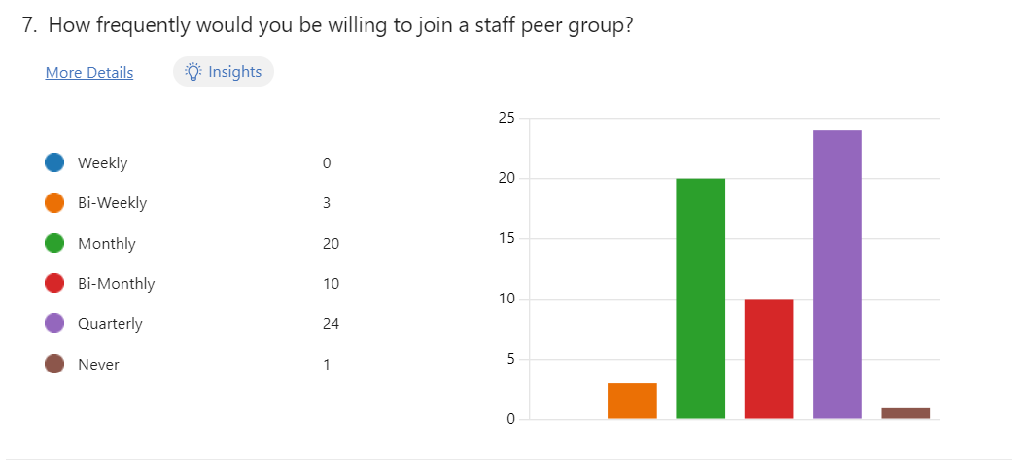
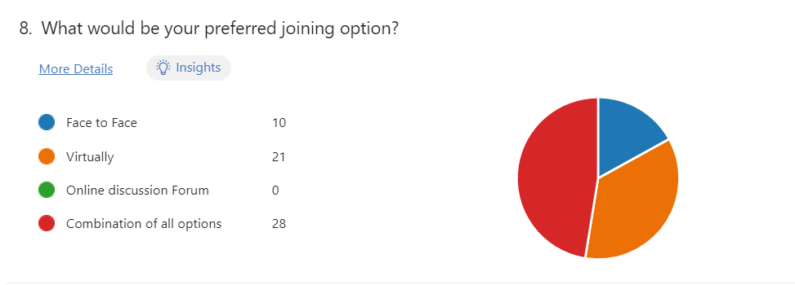
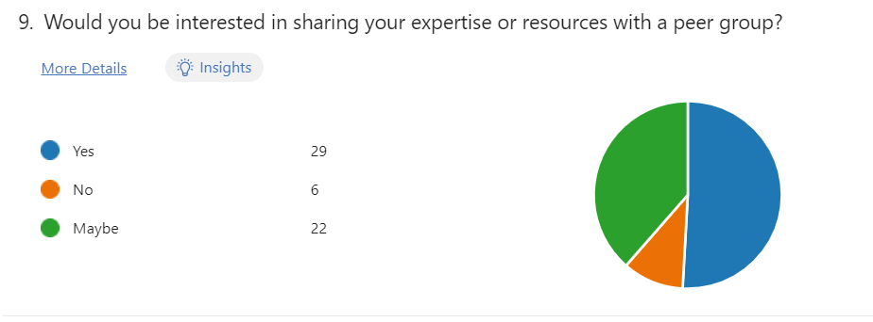
SLT: Staff Networking Survey
90% would prefer monthly, bi-monthly or quarterly forums
46% would like a combination of F2F and Virtual forums
48% said they would share their knowledge, with 36% saying maybe

Slide 7
SLT: Staff Networking Survey
Final thoughts and comments to share:
“Having a clear format and topics to discuss is important to know if it is relevant to attend”.
“I know that we need to prove that we are an effective service and that we are meeting patient contact targets to the commissioners of the service but this sort of support and development for staff will benefit the service provided to the service users, will create a more equitable service as best practice is shared and staff are able to follow standardised operating procedures, rely less on 1:1 supervision for individual cases which takes time to schedule, and can delay treatment being provided”.
“I have learned so much over my career in conversation with more experienced therapists as well as peers who also have much to teach me”.
“From an executive level participation is fully supported and encouraged but at local level managers do not value this use of clinical time and this puts many people off attending, taking on additional roles or participating in events”.
“Guidance would be needed on what is appropriate to include e.g. when should a discussion be moved to a more formal clinical supervision”.

Slide 8
SLT: Staff Networking Survey
Decision Required: Do we want to proceed?
Next steps:
Defining Objectives: Clearly defining the objectives and goals of the peer group based on the identified needs and suggestions from the survey responses.
Structuring the Peer Group: Deciding on the structure of the peer group, including frequency of meetings, format (e.g., in-person, virtual), and membership criteria (if any).
Leadership and Facilitation: Assigning roles and responsibilities for leadership and facilitation within the peer group to ensure effective organisation and coordination. Understanding management position to protect time and give assurance group is valued.
Content and Agenda Planning: Developing a plan for the content and agenda of future peer group meetings, incorporating suggestions from the survey responses such as guest speakers, sharing of experiences, and learning opportunities.
Communication and Engagement: Establishing channels for communication and engagement among group members, including digital platforms for sharing resources, updates, and discussions between meetings.
Evaluation and Feedback: Establishing mechanisms for ongoing evaluation and feedback to assess the effectiveness of the peer group in meeting the needs of SLT teams and making adjustments as necessary.

